Slide 1


AI-Based Voice-Enabled Personal Assistant using Machine Learning
Harsh Srivastava | B.Tech CSE | Manipal University Jaipur

Slide 2
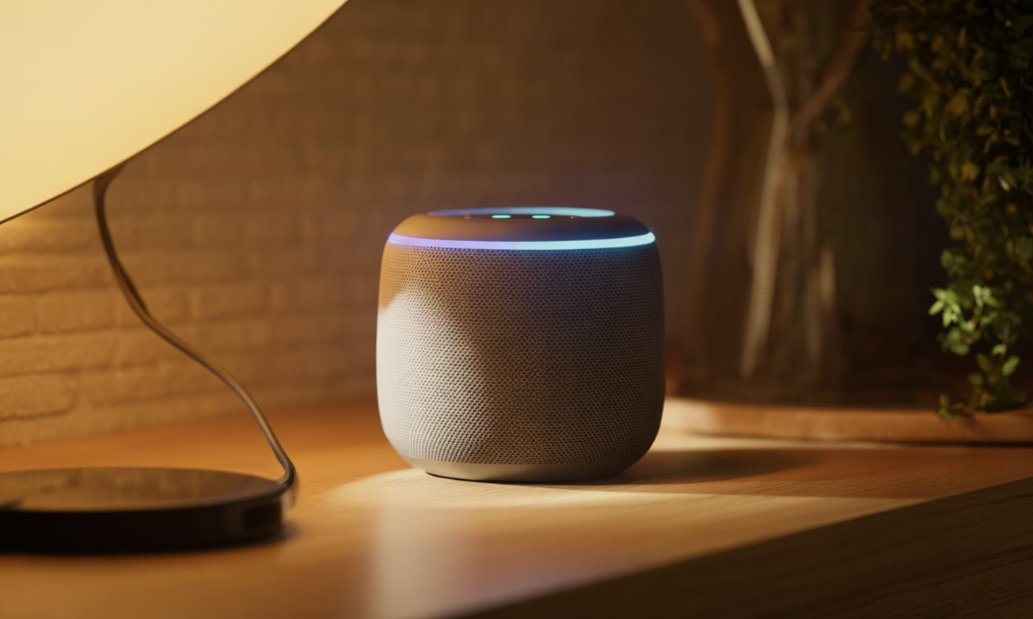
What is an AI Assistant?
An AI assistant is a software that understands what you say and helps you do things. Like having a helper who listens and acts on your commands.
Real Examples
Alexa by Amazon
Google Assistant
Siri by Apple

Slide 3



Why This Project?
Personal Interest
AI & ML Passion
Need for Automation
Always fascinated by how machines can understand human language and learn from it.
Want to explore how machine learning makes computers smarter and more intuitive.
Manual work is time-consuming. AI can automate tasks and make life easier.

Slide 4

Problem Statement
1
Manual interaction is slow
Clicking and typing takes too much time and effort.
2
Not understanding natural language
Current systems need exact commands. They don't get how humans naturally speak.
3
Need a smarter assistant
We need something that understands context and learns from user behaviour.

Slide 5
Project Objectives
01
02
Build AI assistant using ML
Understand user intent
Create a system that learns from data and improves over time.
Make it understand what the user really wants, even with different wordings.
03
04
Perform real-world tasks
Add voice interaction
Actually open apps, search web, set alarms, not just talk.
Make it respond to both voice commands and text input.

Slide 6





Technologies Used
Python
Flask
HTML, CSS, JavaScript
Main programming language for ML and backend logic.
Backend framework to connect frontend with ML model.
Frontend to create interactive user interface.
BERT Model
MASSIVE Dataset
Pre-trained ML model to understand natural language better.
Large collection of text to train the model properly.

Slide 7
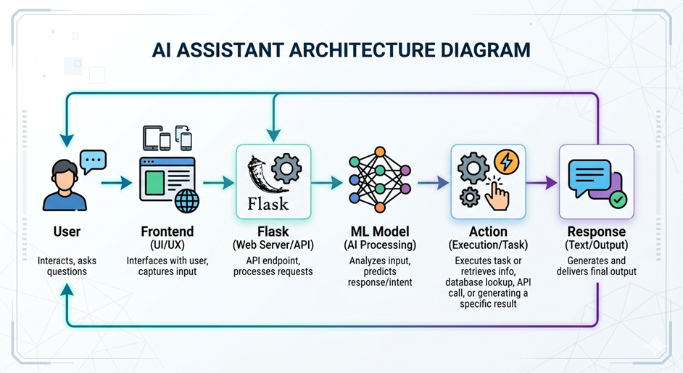





System Architecture
The flow is simple: User gives command → System processes it → ML understands → Action happens → Response comes back

Slide 8
Key Features
Voice + Text Input
Open Applications
Speak or type your commands. Both work perfectly.
Can launch apps like browser, calculator, or editor.
Web Search
Calculator
Search Google and get results without opening browser.
Solve math problems by just speaking the equation.
Set Alarm
Basic Personality
Schedule alarms and reminders using voice commands.
Responds with friendly tone and simple conversations.

Slide 9
Results & Challenges Faced
Successes
Challenges
Commands working successfully
Voice recognition functional
Good response accuracy
Fast processing time
Model training took time
Backend-frontend integration issues
Voice errors in noisy environments
Understanding different accents

Slide 10
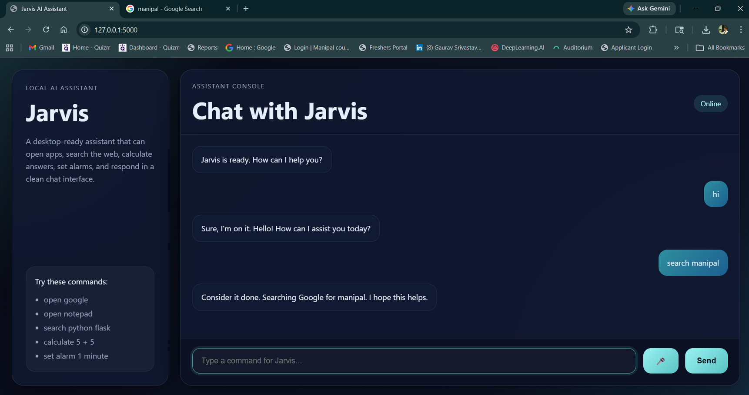
Proof of work

Slide 11
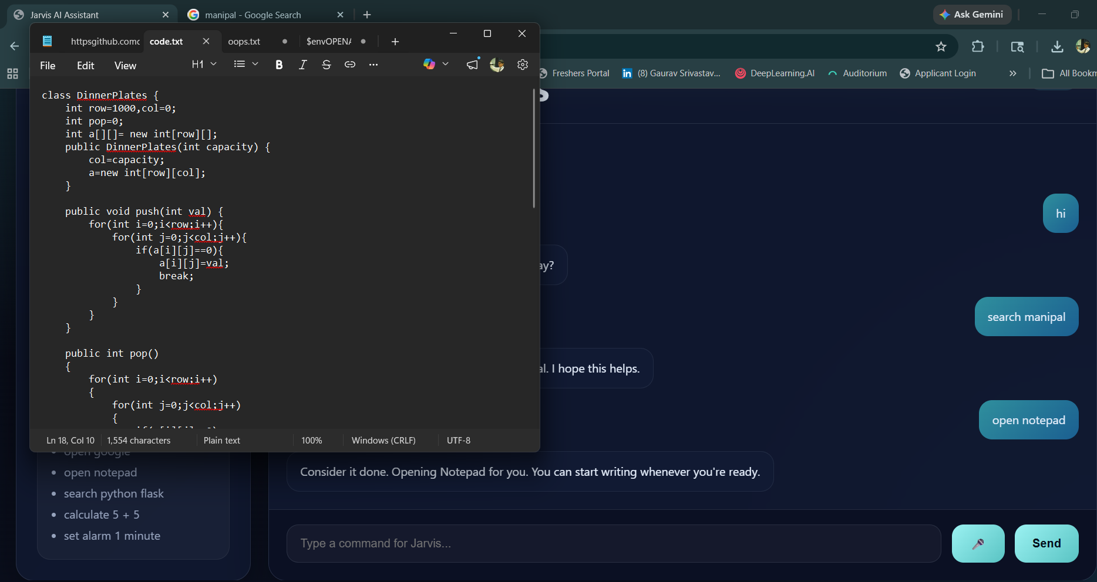

Slide 12





Conclusion & Future Scope
Project Success
Completed working prototype with all basic features functioning properly.
Skills Gained
Learnt ML implementation, full-stack development, and API integration.
Mobile App
Develop Android/iOS version for on-the-go use.
More APIs
Integrate weather, news, and social media APIs.
Wake Word
Add "Hey Assistant" feature like Alexa and Google.

